Slide 1
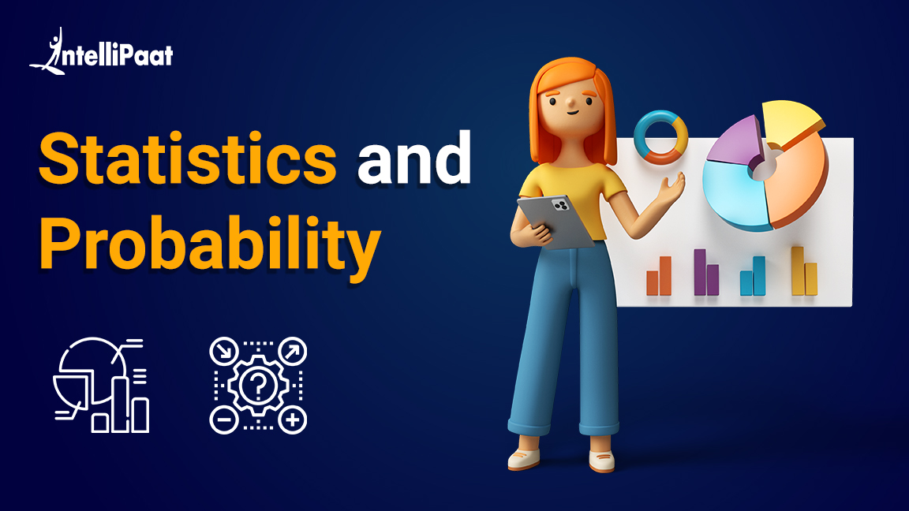

Slide 2

Introduction to Statistics

Slide 3
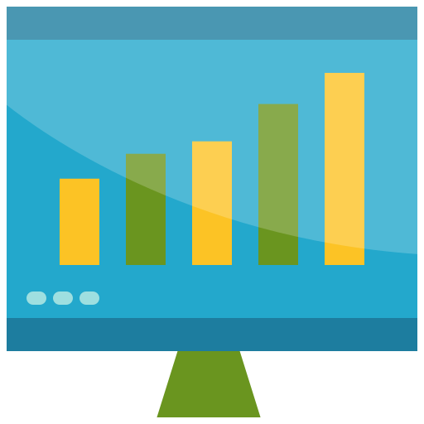
What is Statistics?

Slide 4


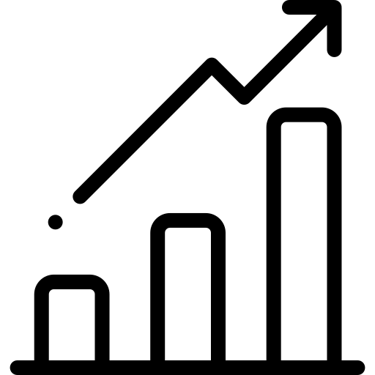
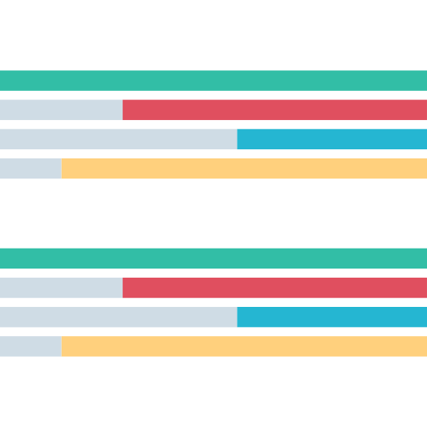
What is Statistics?
Statistics is a branch of Mathematics that deals with collection, analyzing, and interpreting large amounts of data.

Slide 5

Why is Statistics important?

Slide 6
Why is Statistics important?
Statistics allows us to derive knowledge from large datasets and this knowledge can then be used to make predictions, decisions, classifications etc.

Slide 7

Where is Statistics used?

Slide 8




Where is Statistics used?
Statistics are used in various fields, some of them are:
Medical Research
Stock Market
Sales Projection
Weather Forecasting

Slide 9

Sampling

Slide 10



Sampling
Sampling is the process of collecting data to perform analysis on

Slide 11

Sample vs Population

Slide 12
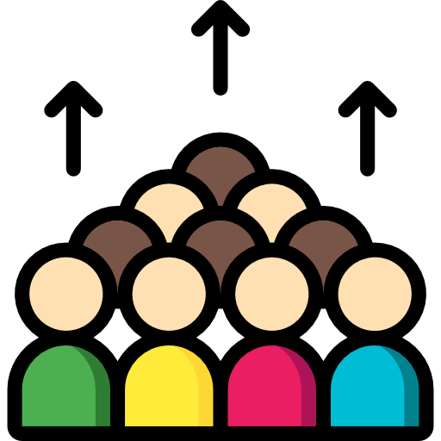


Sample vs Population
Population is the entire dataset such as the whole population of a country, Sample is subset of that population which is analyzed to make inferences

Slide 13

Random Sampling

Slide 14



Random Sampling
Random Sampling is the process of selecting a subset / sample from a population in such a way that every data point is equally likely to be included in the sample

Slide 15
Stratified Sampling

Slide 16
Stratified Sampling
Stratified Sampling is the process of dividing your samples into layers or groups and then performing random sampling for each group

Slide 17

Central Tendencies

Slide 18
Central Tendencies
Central Tendency is used to indicate where does the middle or center of the distribution of our data lies

Slide 19

Mean

Slide 20

Mean
Mean is the average of the data. In simpler terms it’s the sum of values divided by total number of values. It’s represented by Greek letter Sigma
Mean

Slide 21

Mode

Slide 22

Mode
Mode is used to indicate the most frequent data point, in other words the one which occurs most number of times
Mode

Slide 23
Median

Slide 24

Median
Median is the middle of the data. If the data is arranged in ascending order then the data element which occurs right at the center is the median
Median

Slide 25

Variation

Slide 26



Variation
Variation in statistics is used to show how data is dispersed, or spread out. Several measures of variation are used in statistics.
Range
Quartiles
Variance

Slide 27

Range

Slide 28
Range
Range is the difference between the highest and the lowest values in our dataset. Range tells us the distance between the lowest and highest values in our data

Slide 29

Percentiles

Slide 30
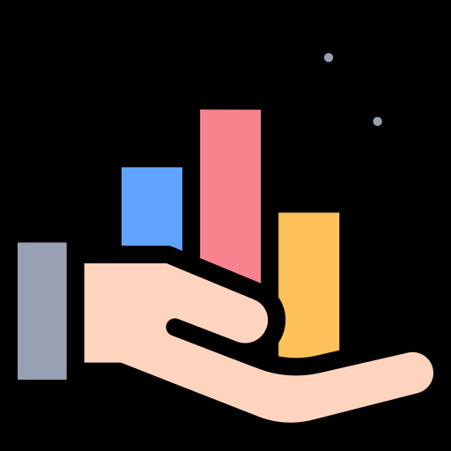
Percentiles
Percentiles are scores that are used to describe a value below which some Observations fall.
E.g.: If X is at 70th Percentile it mean 70% of other data points from our sample are below X

Slide 31

Quartiles

Slide 32

Quartiles
Quartiles are used to break the data into 4 parts so as to better find the spread of data in a way that is less influenced by outliers.
Quartiles are expressed in percentiles. 1st Quartile is 25th Percentile, 2nd Quartile is 50th Percentile (Median) and 3rd Quartile is 75th Percentile

Slide 33
Interquartile Range (IQR)

Slide 34
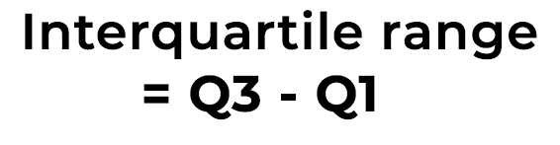
Interquartile Range (IQR)
Interquartile Range (IQR) is the difference between the lower and upper quartile. This gives us a better idea of the range of data.

Slide 35

Standard Variance and Standard Deviation

Slide 36
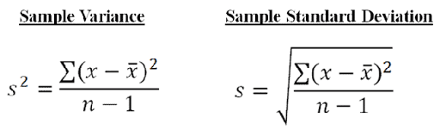
Standard Variance and Standard Deviation
Standard Variance measures how far a set of numbers are spread out from their average value.
Standard Deviation is used to express the magnitude by which the members of a group differ from the mean value for the group.
Standard Deviation is the square root of Standard Variance.

Slide 37

Correlation

Slide 38
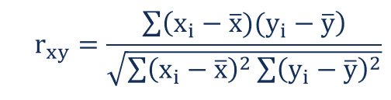
Correlation
Correlation is a term that is a measure of the strength of a linear relationship between two quantitative variables

Slide 39

Positive Correlation

Slide 40

Positive Correlation
Positive Correlation is a term that is used to describe a positive linear relationship between two quantitative variables
Positive Correlation

Slide 41

No Correlation

Slide 42
No Correlation
No Correlation is a term used to describe no linear relationship between two quantitative variables
No Correlation

Slide 43

Negative Correlation

Slide 44
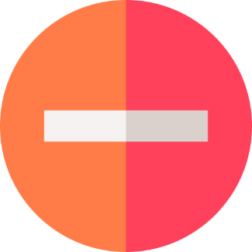
Negative Correlation
Negative Correlation is a term that is used to describe the strength of a Negative linear relationship between two quantitative variables
Negative Correlation

Slide 45

Tables

Slide 46
Tables
A way of presenting statistical data through a systematic arrangement of the numbers describing some mass phenomenon or process
A statistical table may be regarded as representing a subject and predicate. The meaning of each number is indicated by the headings of the corresponding row and column.

Slide 47
Charts

Slide 48
Charts
A statistical graph or chart is defined as the pictorial representation of statistical data in graphical form. The statistical graphs are used to represent a set of data to make it easier to understand and interpret statistical information.

Slide 49
Charts
A statistical graph or chart is defined as the pictorial representation of statistical data in graphical form. The statistical graphs are used to represent a set of data to make it easier to understand and interpret statistical information.
Lets list down the types of charts

Slide 50
Charts
A statistical graph or chart is defined as the pictorial representation of statistical data in graphical form. The statistical graphs are used to represent a set of data to make it easier to understand and interpret statistical information.
Lets list down the types of charts
Types Of Charts
1.Bar chart
2.Histogram
3.Pie chart
4.Box chart
5.Line Graph
6.Scatter plot

Slide 51
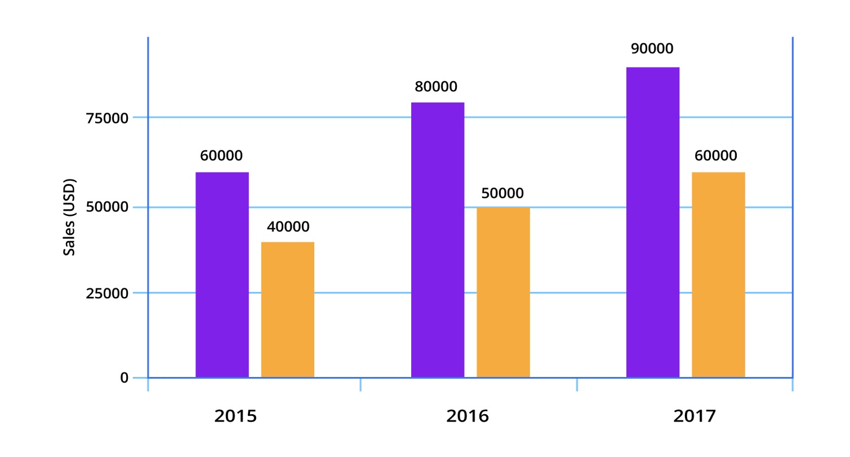
1. Bar chart
Bar charts are among the most frequently used chart types. As the name suggests a bar chart is composed of a series of bars illustrating a variable’s development. Given that bar charts are such a common chart type, people are generally familiar with them and can understand them easily

Slide 52
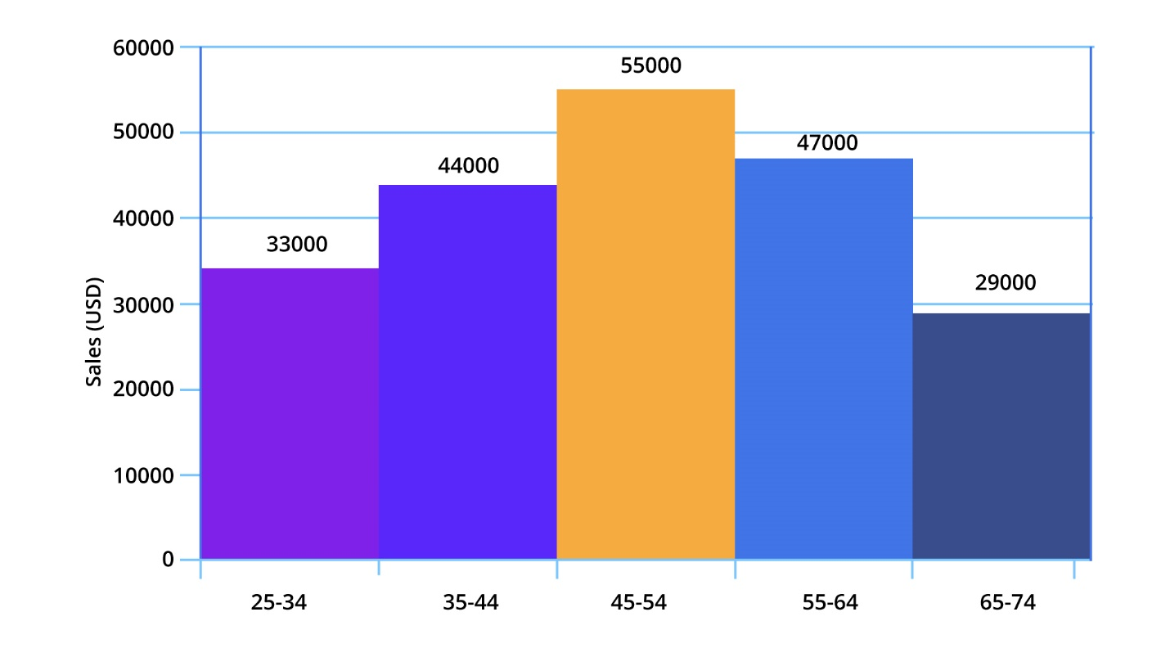
2. Histogram
A series of bins showing us the frequency of observations of a given variable. The definition of histogram charts is short and easy..

Slide 53
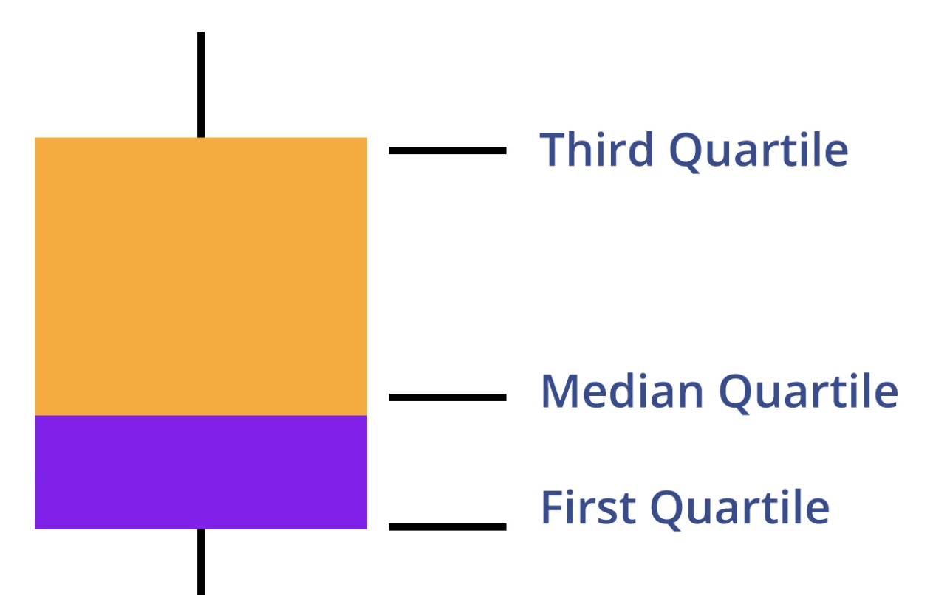
3. Box chart
Box plot, also called the box-and-whisker plot: a way to show the distribution of values based on the five-number summary: minimum, first quartile, median, third quartile, and maximum.

Slide 54
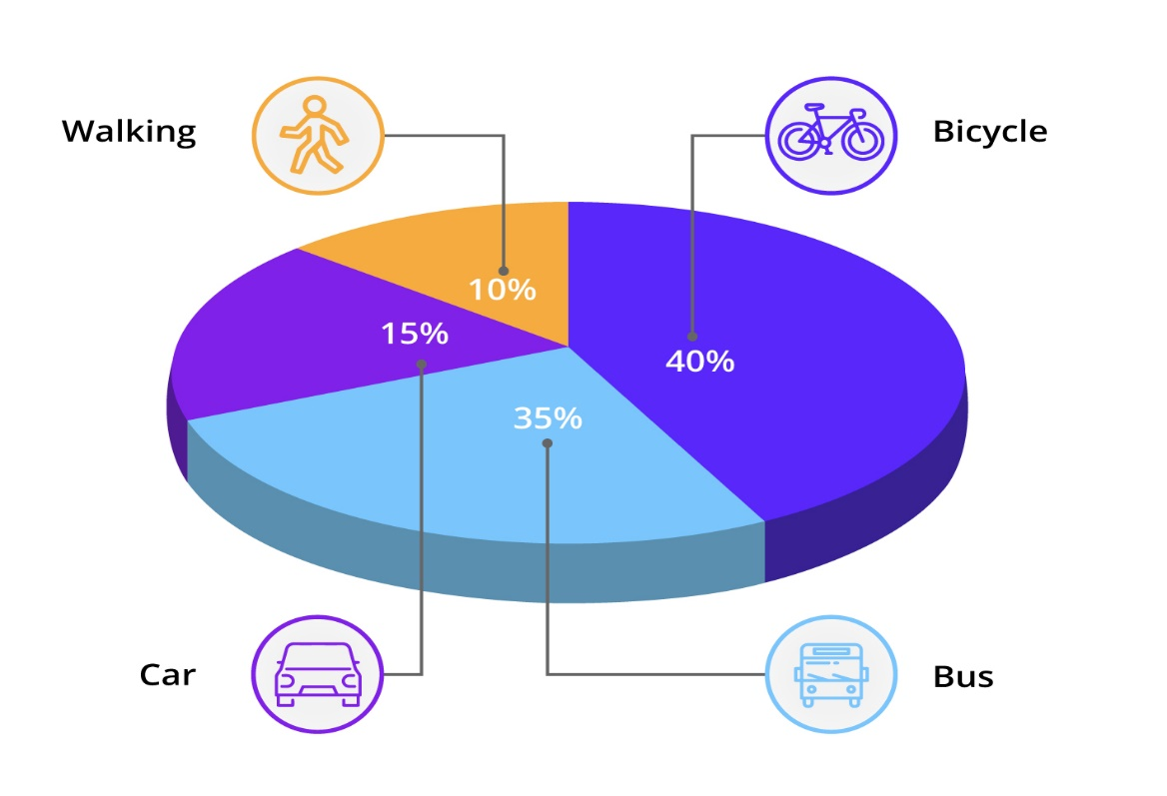
4. Pie chart
A pie chart is a circular graph divided into slices. The larger a slice is the bigger portion of the total quantity it represents.

Slide 55
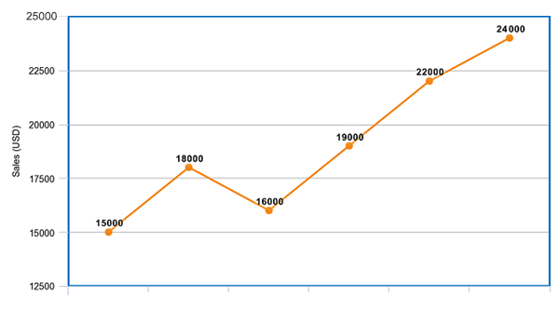
5. Line chart
A line chart is, as one can imagine, a line or multiple lines showing how single, or multiple variables develop over time. It is a great tool because we can easily highlight the magnitude of change of one or more variables over a period.

Slide 56
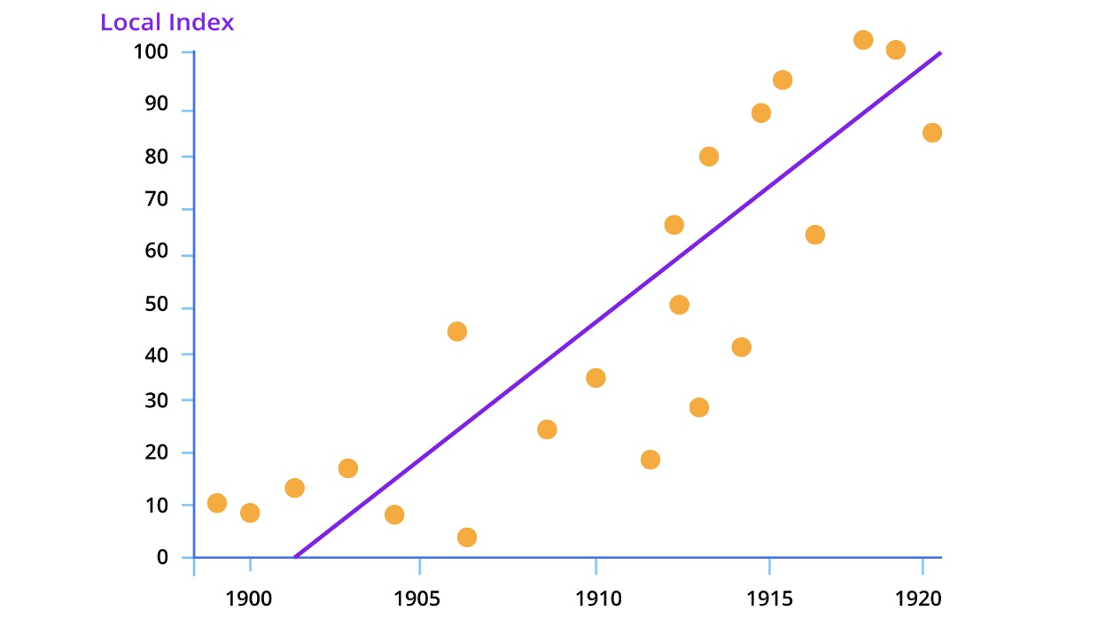
7. Scatter plot
A scatter plot is a type of chart that is often used in the fields of statistics and data science. It consists of multiple data points plotted across two axes. Each variable depicted in a scatter plot would have multiple observations. If a scatter plot includes more than two variables, then we would use different colors to signify that.

Slide 57

Probability

Slide 58
Introduction to Probability
Probability defines the likelihood of occurrence of an event

Slide 59
Introduction to Probability
Probability defines the likelihood of occurrence of an event
Probability can be defined as the ratio of the number of favorable outcomes to the total number of outcomes of an event.

Slide 60
Introduction to Probability
Probability defines the likelihood of occurrence of an event
Probability can be defined as the ratio of the number of favorable outcomes to the total number of outcomes of an event.
Probability can be defined as the ratio of the number of favorable outcomes to the total number of outcomes of an event.

Slide 61
Probability
For an experiment having 'n' number of outcomes, the number of favorable outcomes can be denoted by x. The formula to calculate the probability of an event is as follows.
Probability(Event) = Favorable Outcomes
Total Outcomes

Slide 62



India: +91-7847955955
US: 1-800-216-8930 (TOLL FREE)
sales@intellipaat.com
support@intellipaat.com
24/7 Chat with Our Course Advisor

